Slide 1
VRINDA STORE SALES ANALYSIS
PRESENTED BY
JOSH JEBASTINE

Slide 2
OBJECTIVE
Vrinda stores wants to create an annual sales report for 2022. So that vrinda can understand their customers and grow more sales in 2023.

Slide 3
INSIGHTS TO BE FIND
Month with the Highest sales
Sex Ratio
Top 5 States
Channels Contribution
Products Delivered Details

Slide 4
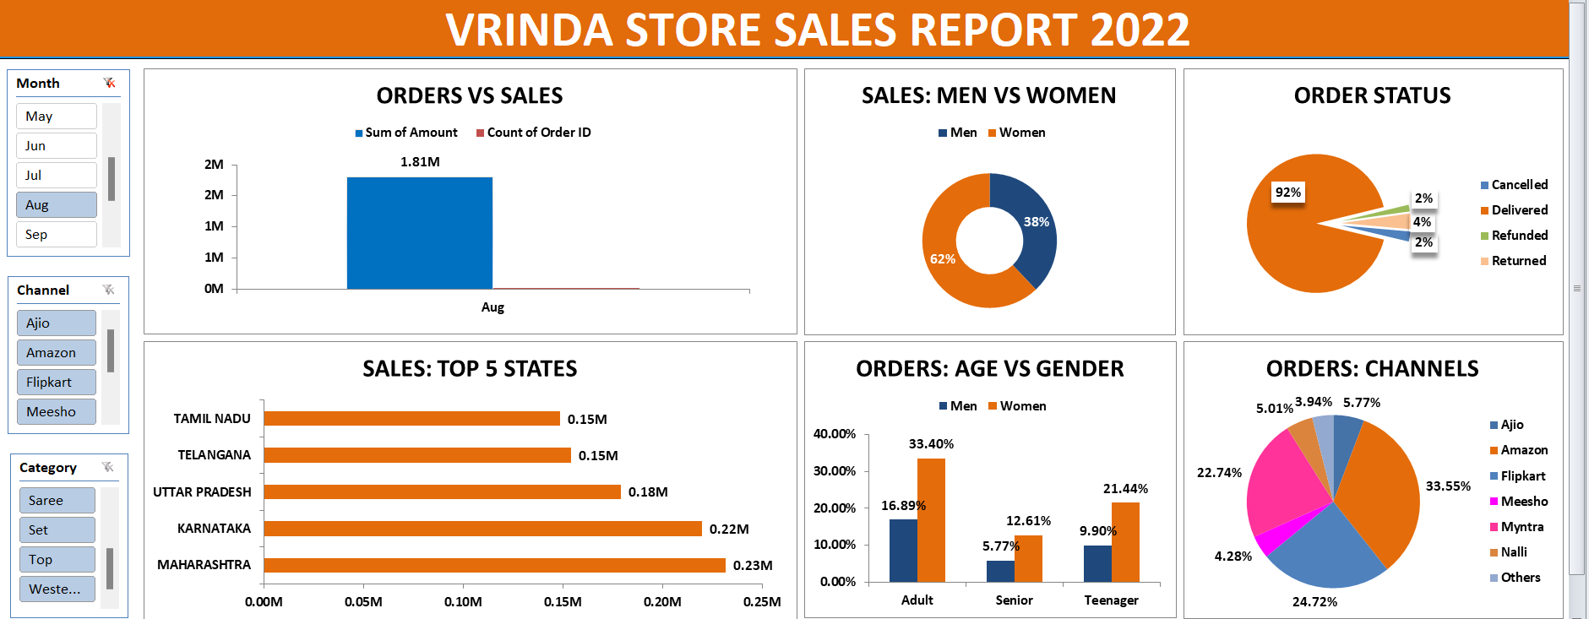
AUGUST MONTH HAS THE HIGHEST SALES

Slide 5
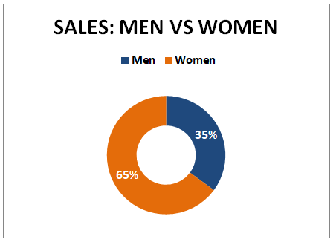
WOMENS ARE MAJORITY CUSTOMERS

Slide 6
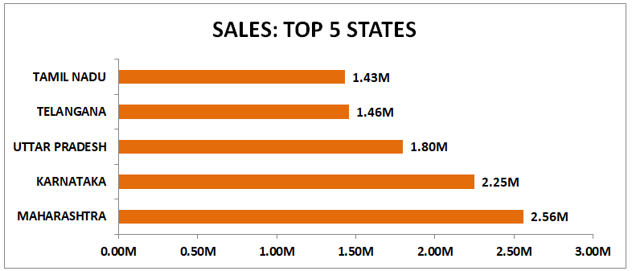
TOP 5 STATES

Slide 7
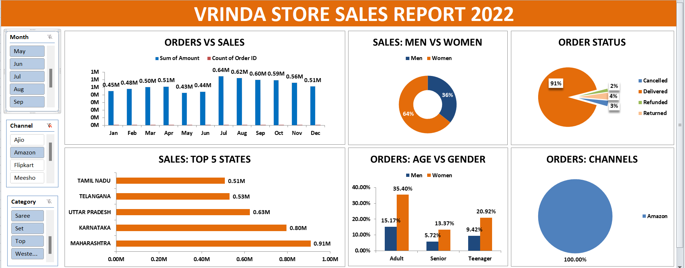
CHANNELS CONTRIBUTION – AMAZON HAS THE HIGHEST SALES

Slide 8
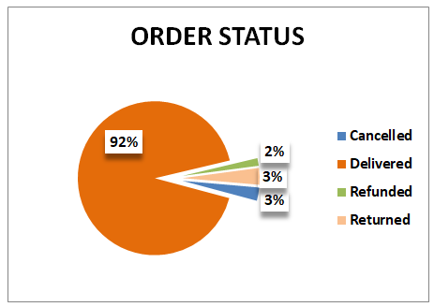
PRODUCT DELIVERED DETAILS

Slide 9
KEY INSIGHTS
WOMEN ARE MORE LIKELY TO BUY COMPARED TO MEN (65%).
MAHARASHTRA, KARNATAKA AND UTTAR PRADESH ARE THE TOP 3 STATES (35%).
ADULT AGE GROUP (30-49) IS MAXIMUM CONTRIBUTING (50%).
AMAZON, FLIPKART AND MYNTRA CHANNELS ARE MAXIMUM CONTRIBUTING (80%).

Slide 10
CONCLUSION – TO IMPROVE VRINDA STORE SALES
TARGET WOMEN CUSTOMERS OF AGE GROUP (30-49) LIVES IN MAHARASHTRA, KARNATAKA AND UTTAR PRADESH BY SHOW ADS/OFFERS/COUPONS AVAILABLE ON AMAZON, FLIPKART AND MYNTRA

